Slide 1

Ragon Institute
Bioinformatics Workshops
Tuesday Meeting 6/19/18
Le Gall Lab
Ann Le, Samuel Patterson, Jiangping Li

Slide 2
Intro to O2
Weds. 6/13

Slide 3

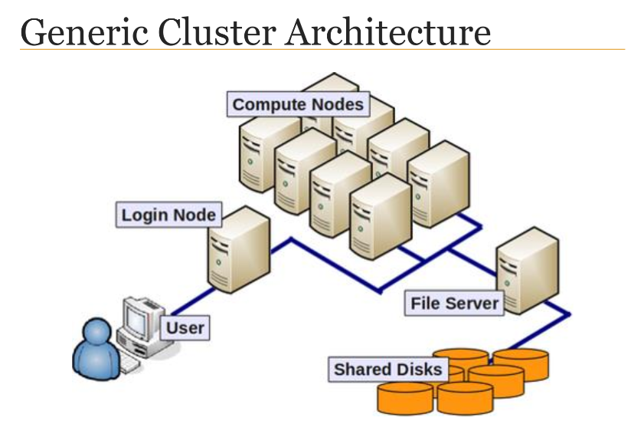
Storage Policies
HMS’s computational cluster
8000+ cores and SLURM batch system
/home/user_id
Quota: 100GB per user
Backup: Daily to 14 days, weekly to 60 days
/n/data1/institution/dept/lab/your_dir
Quota: Expandable
Backup: Daily to 14 days, weekly to 60 days
/n/scratch2 (for data needed temporarily during analyses)
User quota: 10TB and 1 million files/directories

Slide 4
Logging In
Accessed with an O2 account and the secure shell protocol (SSH) via command line
MobaXterm (download from online) for Windows
Terminal for Macs/Linux
$ssh -XY [ECommonsID]@o2.hms.harvard.edu
Will log you into a “shell login server” after you type in password
In home directory by symbol “tilde” = “~”
In bash environment to accept commands by symbol “$”

Slide 5
Interactive Session
Login servers not designed for intensive processes so have to run jobs in interactive sessions
$srun --pty -p interactive -t 0-12:00 --mem 8G bash
srun --pty = how interactives are started
-p interactive = partition
-t 0;12:00 = time limit of 12 hours
--mem 8G = memory requested
Interactive sessions symbolized by “[ECommonsID]@compute-a-16-162:~$”

Slide 6
Software
Commonly used software is held in a repository and loaded per session
Python, R, Perl, MATLAB
Load/unloading modules
$module [un]load software/version
Installing/compiling (unzipping in /home or /n/groups directories) software:
$wget http://path/to/binary/mysoftware/tar/gz
$tar -zxvf mysofrware.tar.gz

Slide 7
Jobs
In interactive session, programs can be called directly
$bowtie -n 4 hg19 file1_1.fq file1_2.fq
From login shell/interactive session, programs submitted to O2 via a job
$sbatch myjobsfile.run
Recommended to put parameters INSIDE shell script with “#” or “hashtag” as comment instead of writing in command line

Slide 8
sbatch Script
#!/bin/bash
#SBATCH -c short #Partition to submit to
#SBATCH -t 0-00:01 #Time day-hr:min
#SBATCH -c 1 #Number of cores requested
#SBATCH -N 1 #Ensure that all cores are on one machine, 1 is default
#SBATCH --mem=2G #Memory total in GB
#SBATCH -o hostname.%j.out #Standard out goes to this file
#SBATCH -e hostname.%j.err #Standard error goes to this file
srun -c 1 date & #Can run 1 job or many jobs in parallel!
srun -c 1 sleep 2m &
srun -c 3 date
wait #Necessary part of script

Slide 9
Intro to R/Bioconductor
Fri. 6/15

Slide 10

What is R?
Statistical language
Free!
Bioconductor has packages for workflow in R
Let’s learn how to R on O2!

Slide 11
R on O2
Log into O2
$ssh -XY [ECommonsID]@o2.hms.harvard.edu
Load a version of R
[ECommonsID]@login01:~$module load R/version
Set up O2 R library if first time
[ECommonsID]@login01:~$mkdir -p ~/R-version
[ECommonsID]@compute-a:~$export R_LIBS_USER=”~R-version”
Start R from an interactive session
[ECommonsID]@compute-a:~$R
Set up directory to store future R code in R for O2
>setwd(“/Users/legalllab/MyDataDirectory”)

Slide 12
Installing Packages in R
Install packages through Bioconductor (Provides tools for analysis and high-throughput genomic data)
>source(“http://bioconductor.org/biocLite.R” (Download Bioconductor first)
>biocLite(“nameofPackage”)
Install packages through CRAN (Comprehensive R Archive Network)
>install.packages(“name-of-package”)
Install packages through Github
>install.packages(‘devtools’) (Install devtools first)
>install_github(“repo/package”)
Confused on an R function?
>?[name_of_function]

Slide 13
R Variables and Data Types
Assigning variables
>myX <- 5
Vectors: all the same data type
>myVector <- c(1,2,3)
Lists: mixed data type like numeric, character, logical
>myList <- c(3, “TP53”, FALSE)
Matrices: all the same data type and columns must have same length
>myMatrix <- matrix(c(1,2,3,4,5), nrow=3, ncol=2)
Many others can be created
Can be manipulated by indexing, adding/joining rows/columns

Slide 14
Import/Export Data and Run R
Text file, MS Excel, SPSS, SAS, STATA
Tutorial shown with an example from the workshop class

Slide 15
Further Reference
Intro to O2
https://github.com/hmsrc/user-training/blob/master/IntroToO2_Spring2018_v2.pdf
Intro to R/Bioconductor
https://github.com/hmsrc/user-training/blob/master/R_BioconductorSpring2018v1.pdf

